Slide 1



GRADUATION PROCESS
Keeping you in the know!

Slide 2
SPRING COMMENCEMENT
DATE: THURSDAY, MAY 14, 2026
TIME: 10:00 AM

Slide 3
01.
HOW CAN A FACULTY ADVISOR TELL IF A STUDENT HAS FILLED OUT A GRADUATION APPLICATION?
02.
WHAT DOES A FACULTY ADVISOR NEED TO DO TO VERIFY THAT A STUDENT IS READY TO GRADUATE?
03.
WHAT CAN A FACULTY ADVISOR DO TO ENCOURAGE STUDENTS TO FILL OUT GRADUATION APPLICATIONS?
OVERVIEW

Slide 4

YOUR ROLE AS
AN ADVISOR
1. Monitor Applications: Know which of your students have submitted their application(s) to graduate.
2. Verify Readiness: Perform an academic review (EVAL) to confirm a student is on track.
3. Encourage & Guide Students: Help students find the application and understand the deadlines.

Slide 5

STUDENT GRADUATION PROCESS
Meet with your advisor
Submit Graduation Application(s)
Order your regalia if participating in the ceremony
Attend 1 Graduation Practice
Arrive early on Graduation Day

Slide 6
MEET WITH YOUR ADVISOR
Have your advisor review your student record to determine if you are eligible to graduate this semester. We get a fair amount of applications from students nowhere near graduating.
Advisors will also be able to advise on Stackable Credentials.

Slide 7
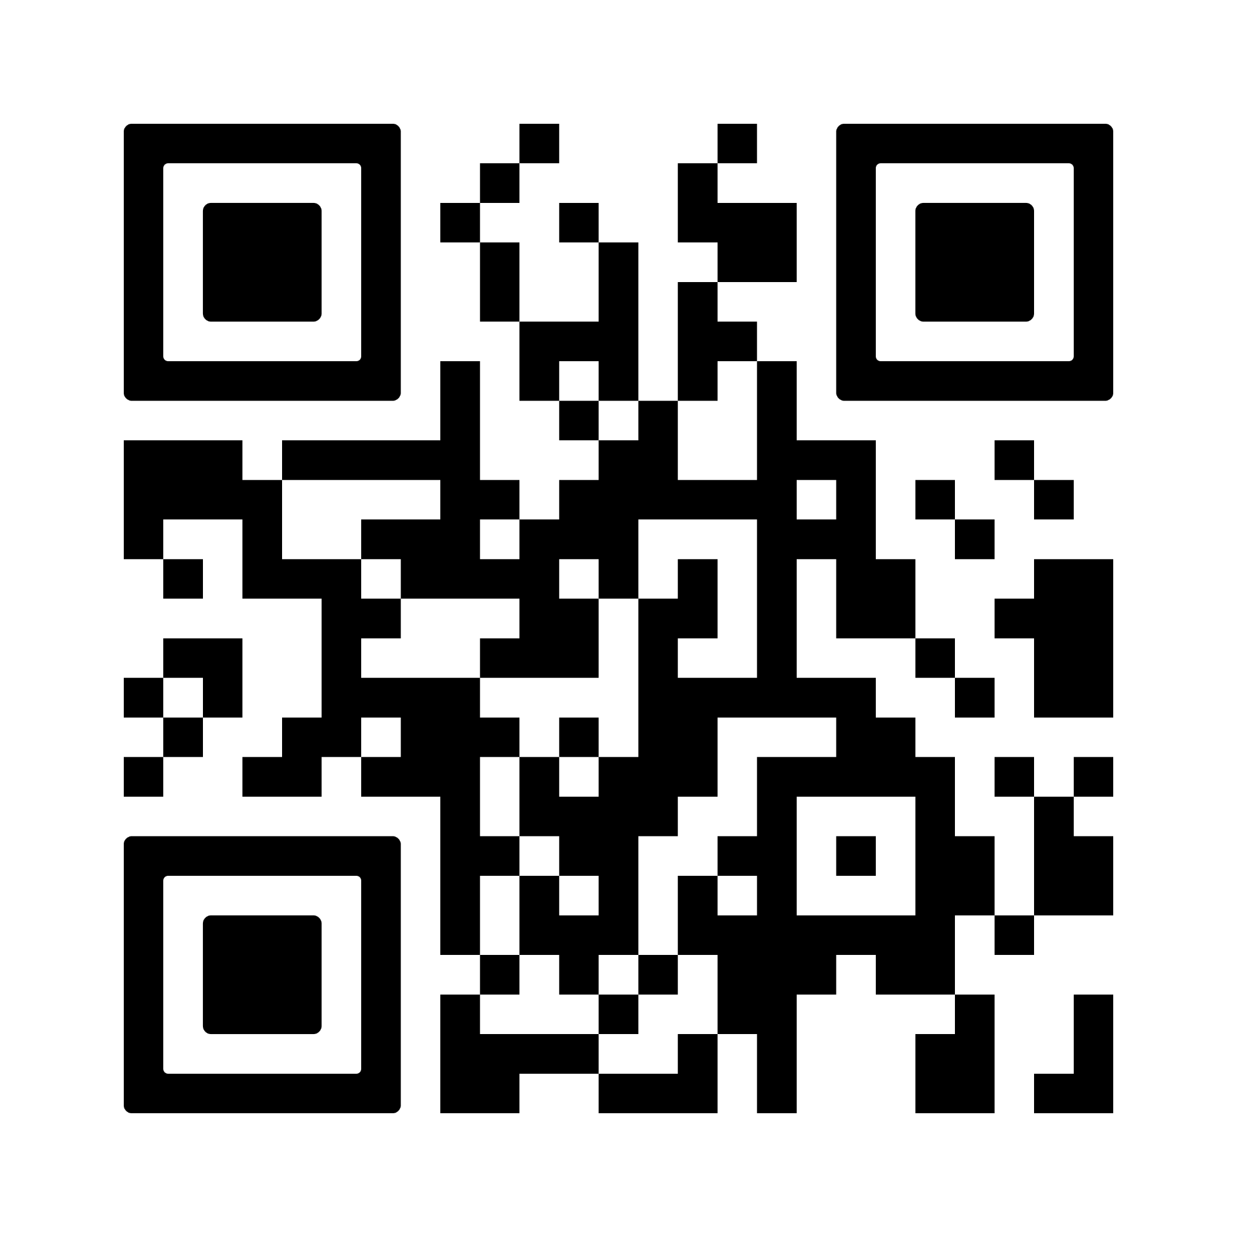
SUBMIT GRADUATION APPLICATION(S)
Students may access the Graduation Application in their Success Hub or by using the following link:
https://apply.cccc.edu/register/gradapp
The Graduation Application opens the first day of each semester.
The Fall Grad App deadline is October 17, 2025.

Slide 8

ORDER YOUR REGALIA
For those participating in the Graduation Ceremony, regalia (cap, tassel, and gown) is required.
Herff Jones, our regalia partner, takes orders and ships them in time for the Ceremony.

Slide 9
ATTEND A GRADUATION PRACTICE
We always have practice and information sessions for graduates walking in the ceremony. Spring requires 4 to allow the larger group of graduates to attend a practice. While not required, practice informs students and prepares them for the busy ceremony.

Slide 10

ARRIVE EARLY FOR GRADUATION
It’s important for graduates to arrive 45 minutes before the ceremony dressed in regalia.
With so many moving parts and participants, we use that time to get graduates in walking order and address any last minute issues that may come up.

Slide 11
GRADUATION APPLICATION PROCESS:
MONITOR APPLICATIONS

Slide 12
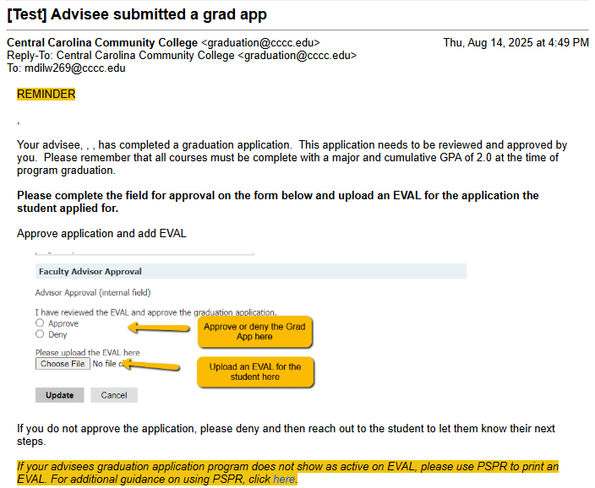
STUDENT SUBMITS GRAD APP(S)
When a student submits a Grad App, Advisors will receive an email alerting them to the new application.
The student also receives an email confirmation of their submission.
Advisors may use the link provided to access the application.

Slide 13
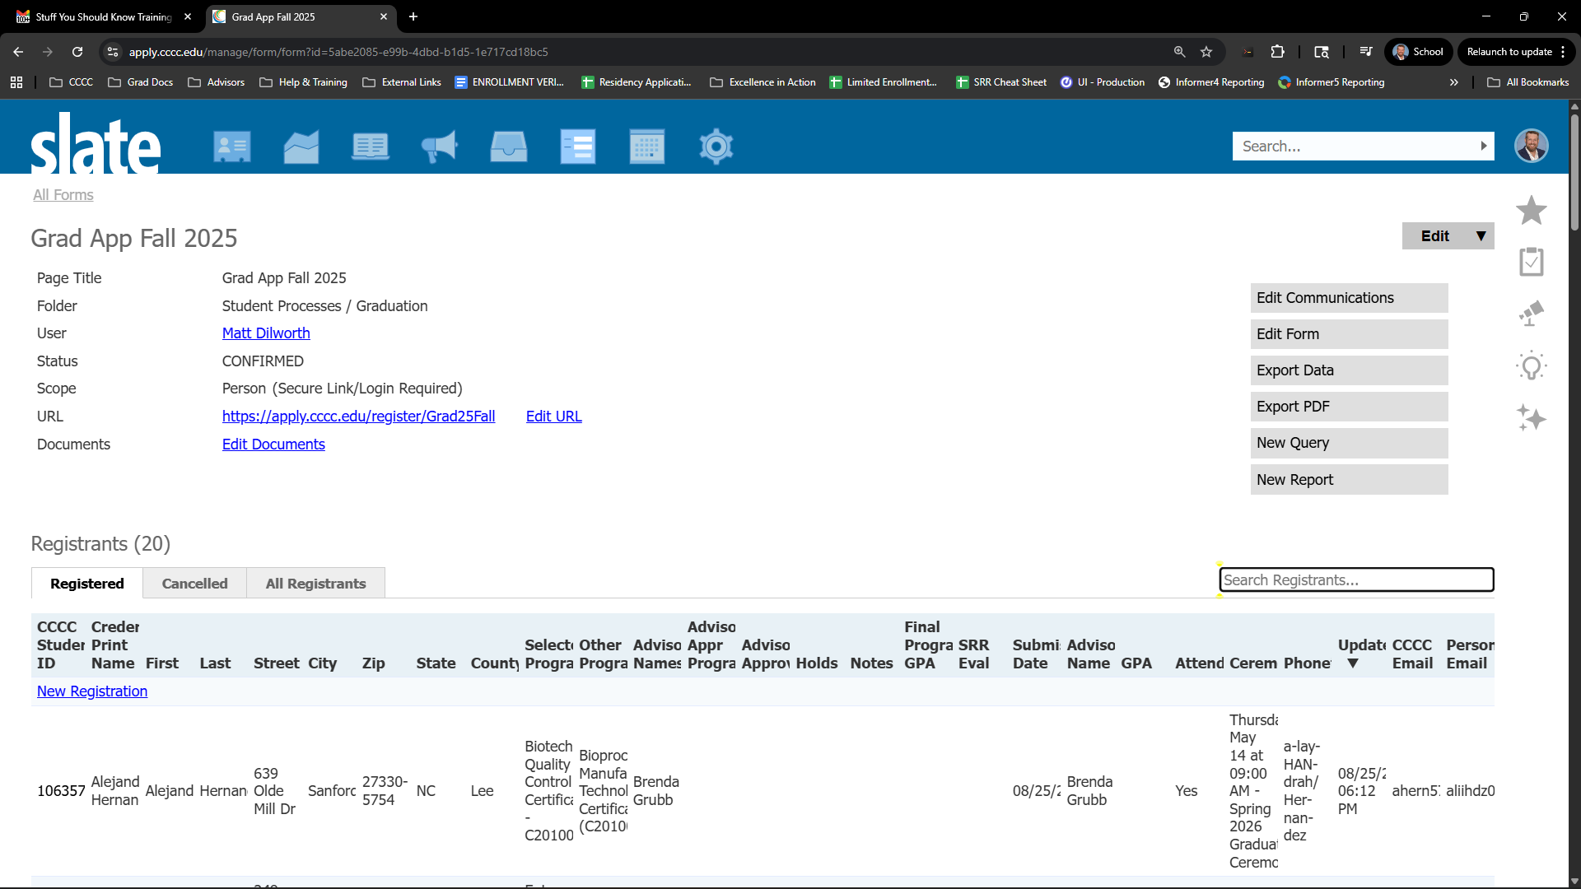
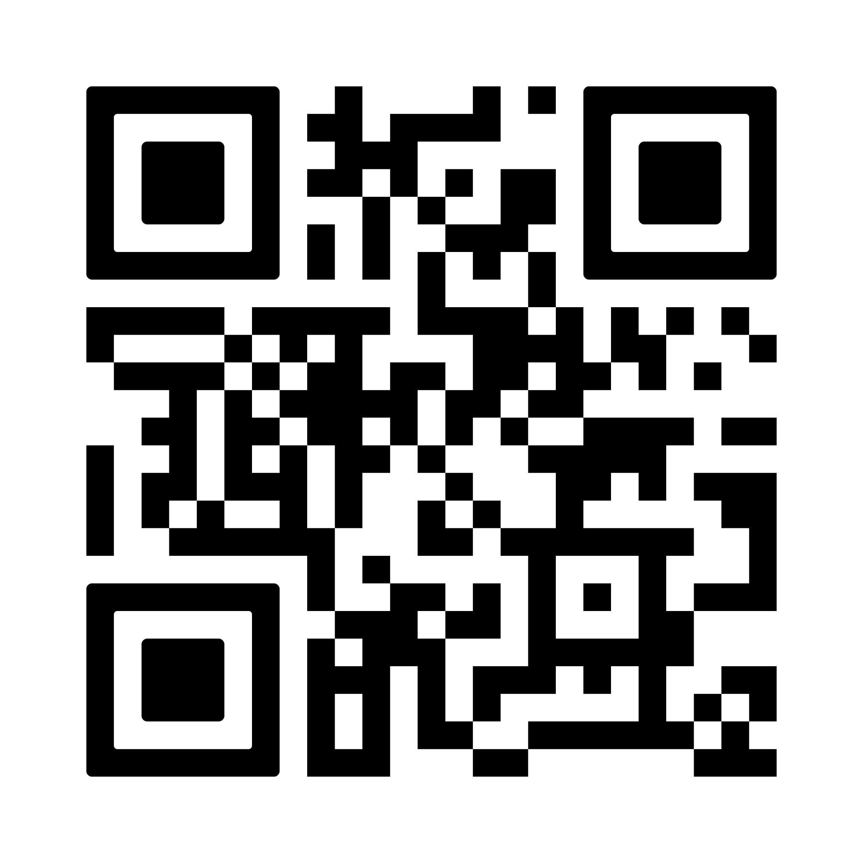
USING THE GRADUATION APPLICATION
Spring Graduation Application: https://apply.cccc.edu/manage/form/form?id=bd954643-2bf1-4257-9f5e-4274f58da069

Slide 14
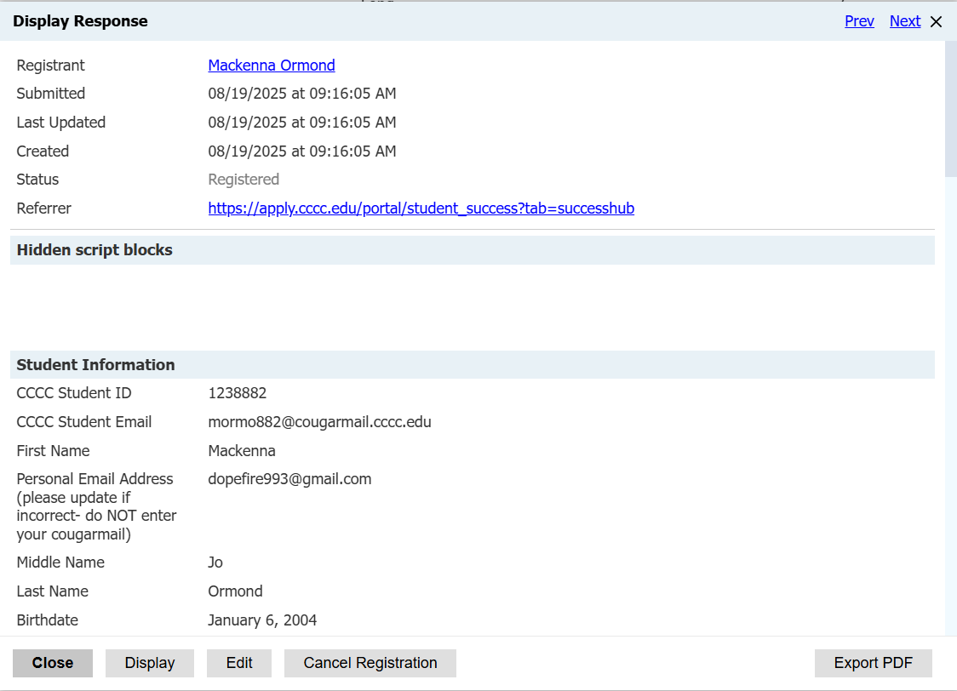
USING THE GRADUATION APPLICATION
When clicking on an application, you will be presented with the individual application pop-up.
You will click the “Edit” button.

Slide 15
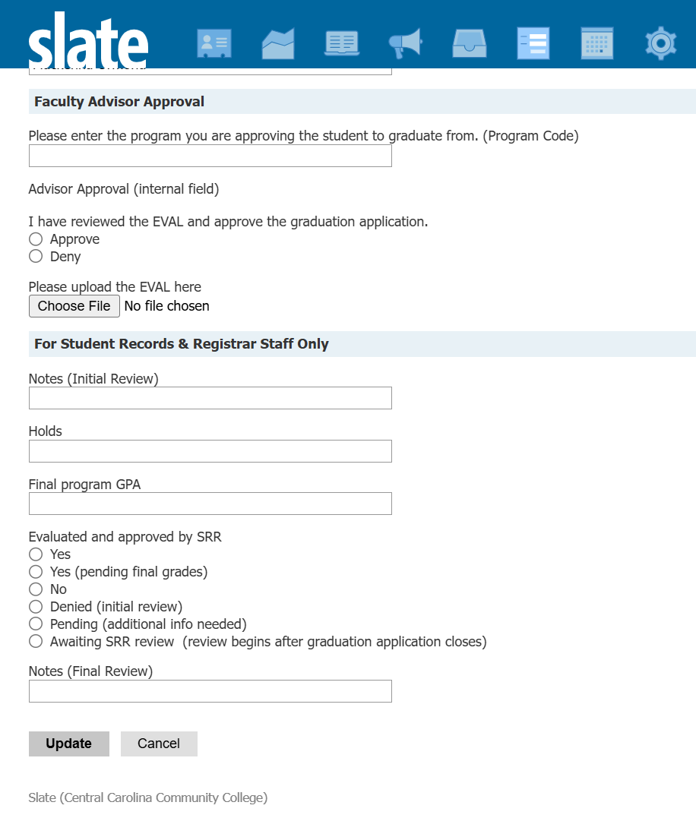
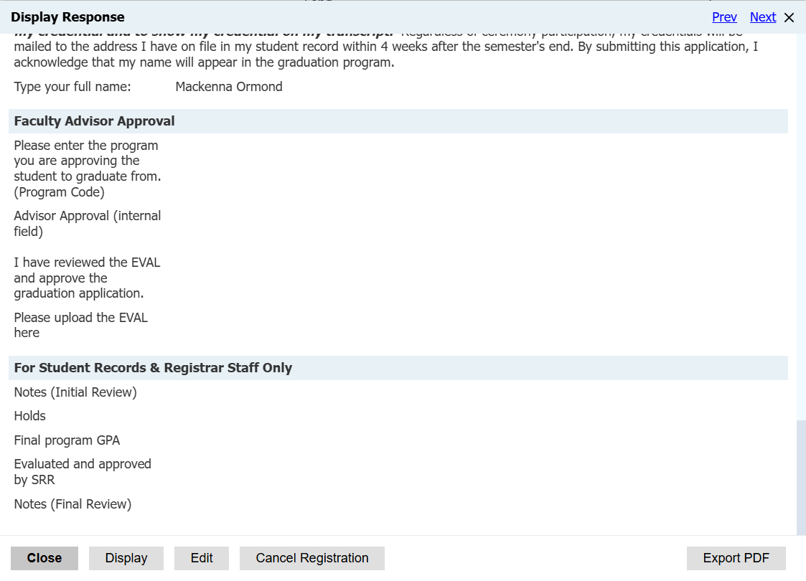
USING THE GRADUATION APPLICATION
Scroll down to the “Faculty Advisor Approval” section.
Here, you will enter the program code for the corresponding program.
You will also Approve or Deny here.

Slide 16
GRADUATION APPLICATION PROCESS:
VERIFY READINESS

Slide 17
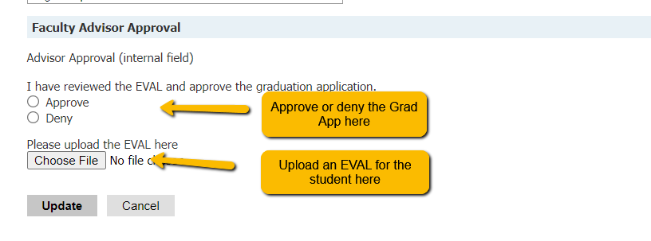
USING THE GRADUATION APPLICATION
Along with the Approval or Denial, Advisors will upload an EVAL for the student and program.
Use Colleague to perform an EVAL and upload the resulting document here.

Slide 18
USING THE GRADUATION APPLICATION
Repeat this process for each of a student’s applications.

Slide 19

STACKED CREDENTIALS
Administration has also approved a return to awarding all credentials a student has earned.
Previously, only the highest credential was awarded (ex., Associate instead of Diploma/Certificate in the same discipline).
Based on student feedback, we will now award every credential earned.
Students must submit a separate graduation application for each credential.
If students participate in the ceremony, they will walk with their highest credential.

Slide 20
MULTI-PROGRAM GRADUATES
Some students will graduate from multiple programs
Students must submit an application for each program (and credential level) from which they wish to graduate.
This is important for SRR and Faculty to track all graduates and credentials

Slide 21
GRADUATION APPLICATION PROCESS:
ENCOURAGE & GUIDE STUDENTS

Slide 22

YOUR ROLE AS
AN ADVISOR
1. As Faculty Advisors, you’re in the best position to identify students fulfilling their requirements in a program.
2. You’ve been advising them since they entered the program and you are trusted educational and professional guides.
3. You’re able to anticipate issues and resolve them early.

Slide 23
CHALLENGES
Stuff You Should Know

Slide 24
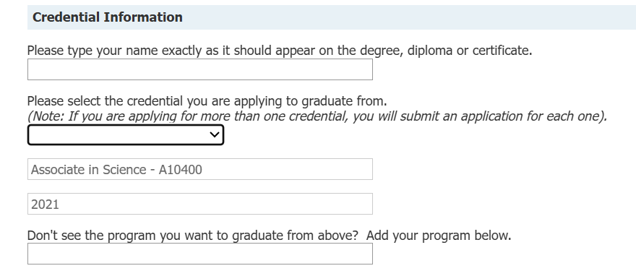
STUDENT SELECTION OF PROGRAM
Only programs showing in the drop-down box are programs on the student’s record.
Once a student selects from the dropdown menu, the fields will populate. Please note: Once populated, the fields can not be deleted or edited.
Stackable Credentials mean that they will not see the lower credentials to choose from after their first application for the highest.
The student will need to submit the first, then start a new one. This time, they will need to enter the lower credentialed program in the empty field where indicated.

Slide 25
STUDENT SELECTION OF PROGRAM
Only programs showing in the drop-down box are programs on the student’s record.
Similar to the Stackable Credentials, if a student wishes to graduate from multiple programs, a separate application is needed for each.
For example, a student graduating from A10500 and A10400 needs 2 apps, one for Associate in Engineering and one for Associate in Science.

Slide 26
THANK YOU
Questions?
Matt Dilworth
919-718-7063
mdilw269@cccc.edu

